Slide 1
Breadth First Search Optimization
High Performance Programming with Multicore & GPUs
By Chen-Yu Chang

Slide 2
Graph Traversal

Slide 3
Definition
Graph traversal refers to the process of visiting each vertex in a graph. Such traversals are classified by the order in which the vertices are visited.

Slide 4
Procedure
Graph
Adjacency List
Adjacency Matrix
Undirected Graph
Find Connections
Match from parent nodes
Check Visited
Record when the node is visited
Prevent from repeating
How Fast: O(|V|+|E|) (Worst Case) where V (vertices), E (Edges)

Slide 5
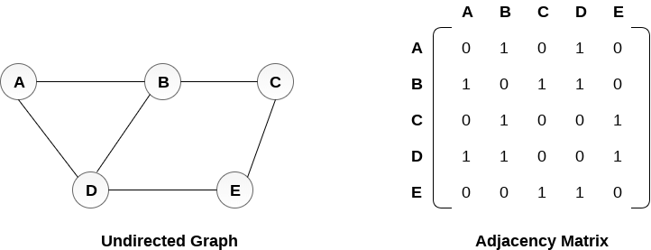
Graph Traversal
Image Source: https://www.javatpoint.com/graph-representation

Slide 6
Breadth First Search

Slide 7
Definition
BFS is an algorithm for traversing or searching tree or graph data structures. It starts at the tree root, and explores all of the neighbor nodes at the present depth prior to moving on to the nodes at the next depth level.

Slide 8
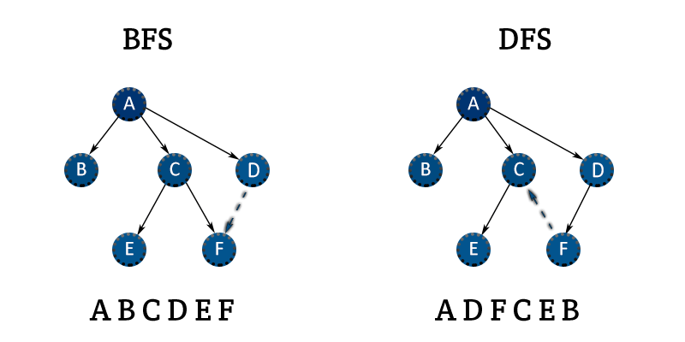
Compare to DFS
Unlike BFS, DFS explores the node branch as far as possible before being forced to backtrack and expand other nodes.
Image Source: https://open4tech.com/bfs-vs-dfs/

Slide 9
Serial Method

Slide 10
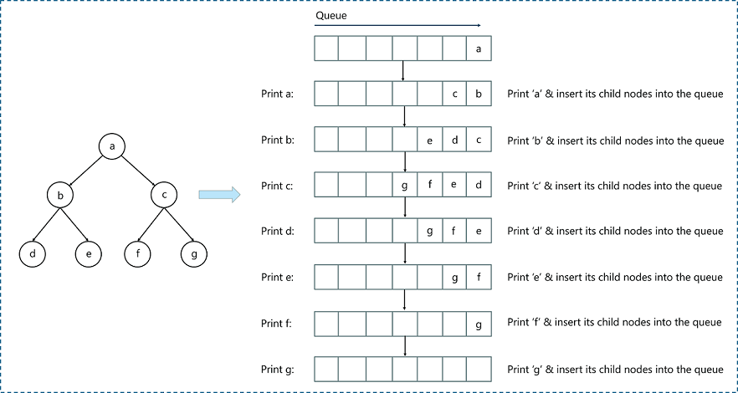
Method: Queue
Key: When the node is visited, add to the queue. After going to the next level, dequeue the previous node and add the new ones
Image Source: https://www.edureka.co/blog/breadth-first-search-algorithm/

Slide 11
Challenges
Need to set a high capacity for he queue if we operate BFS for huge graph
In huge graph, BFS will operate slowly since all the other levels need to wait for the previous levels
Memory access is another constraint : O(V²)
Including Parents, Visited, Queue, and Graph arrays

Slide 12
Hybrid Algorithm

Slide 13
Definition
Set the targeted node and find the nodes that are adjacent (same distance to the root node). Group them based on breadth.

Slide 14
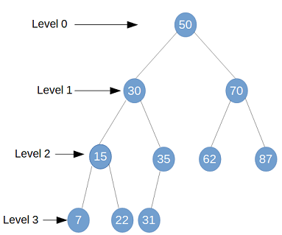
Advantage
Instead of node by node, the whole algorithm categorize the nodes into groups
Potential improvement can be operating multiple nodes at the same time
Image Source: https://www.netjstech.com/2019/03/binary-tree-traversal-breadth-first-serach-link-order-java.html

Slide 15
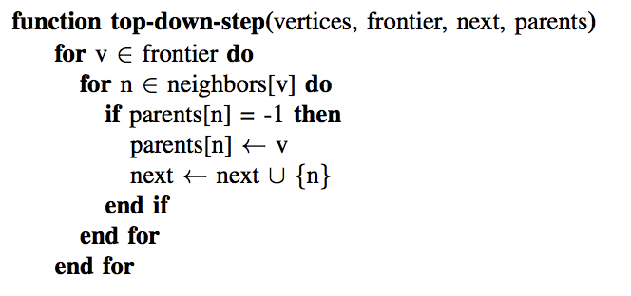
Top-Down Method: O(E)
Efficient on small frontier
Loop the current frontier and its neighbors
If not visited, add to the next frontier
Image Source: http://www.scottbeamer.net/pubs/beamer-sc2012.pdf

Slide 16
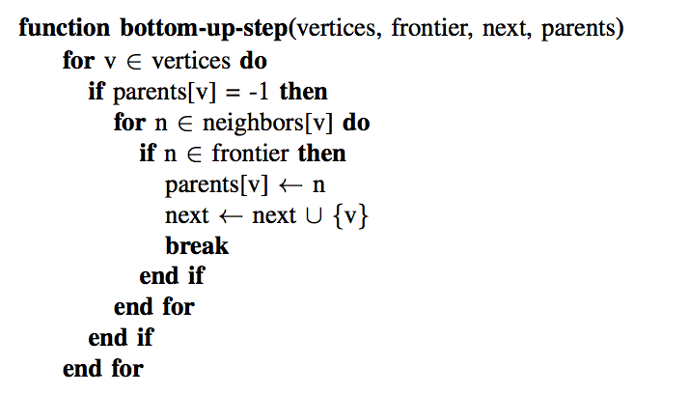
Down-Top Method: O(NV+E)
Efficient on large frontier
Find the nodes’ parents that are not in the current frontier
Image Source: http://www.scottbeamer.net/pubs/beamer-sc2012.pdf

Slide 17
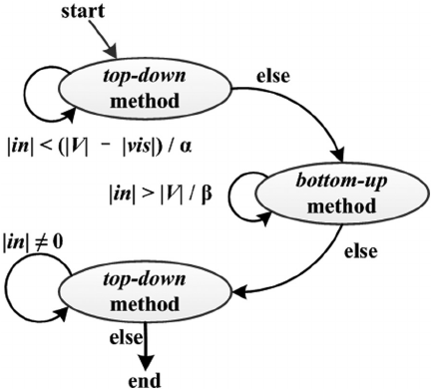
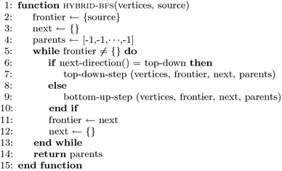
Hybrid
Image Source: https://link.springer.com/article/10.1007/s41019-016-0024-y
Image Source: https://www.researchgate.net/figure/The-state-machine-of-the-hybrid-BFS-algorithm_fig1_260824238

Slide 18
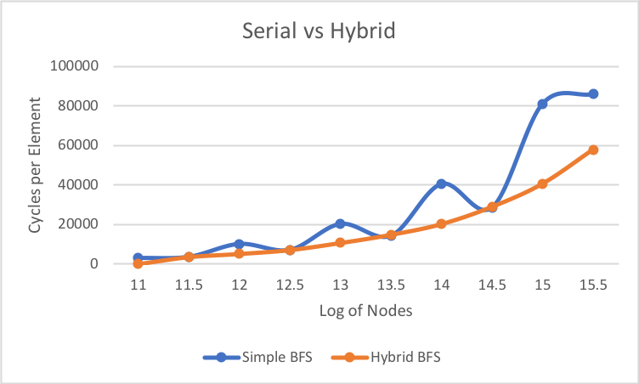
Data Comparison
By comparing the cycles per element, we gain the data from using the serial code & hybrid code.
Overall, the hybrid approach seems to decrease the iterations and shows a better control on frontiers

Slide 19
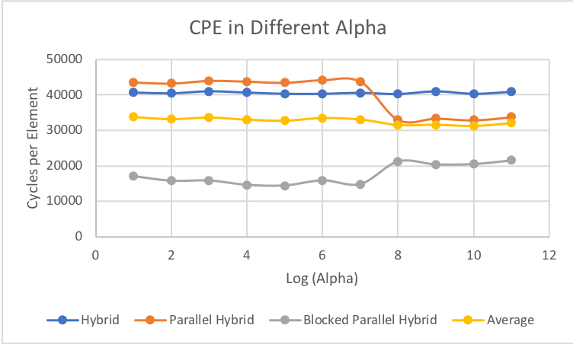
𝞪 (Alpha)
Determine when the frontier is too large
From the data:
When there are 32768 nodes, the optimized Alpha is at about 1024.
It also shows the logical result in the graph on the right.
Usage: Compensate for bottom-up finishing

Slide 20
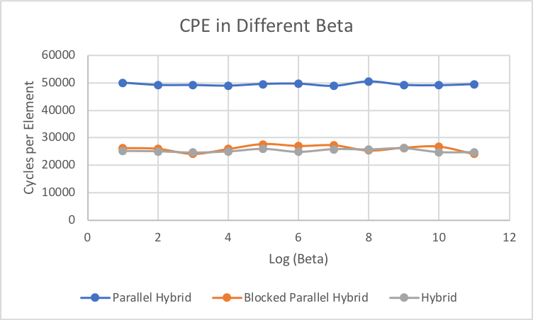
𝞫 (Beta)
Less important comparing to alpha
Check whether the frontier has appropriate size
From the data:
When there are 32768 nodes, the optimized Alpha is at about 16.
Usage: Compensate for up-bottom finishing

Slide 21
Parallelization

Slide 22
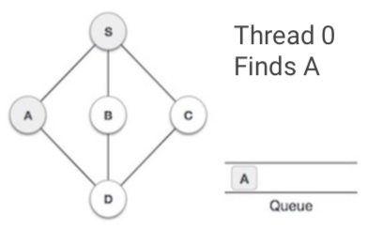
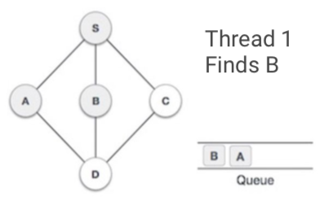
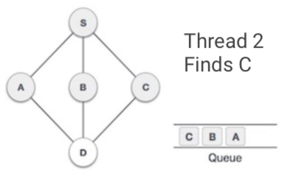
Serial Method with Parallelization: Threads
We see an adjacent node from S, which is A, B, C. For example, we find A and enqueue it.
Then, we enqueue and mark visited B that is adjacent from S.
Finally, the next adjacent node C is visited and enqueue.

Slide 23
Serial Method with Parallelization: Threads
The head of the queue is shared to all threads
The threads will split into several neighbors to visit
The threads will wait for the next update of the queue; otherwise, it stays in rest
Queue is locked

Slide 24
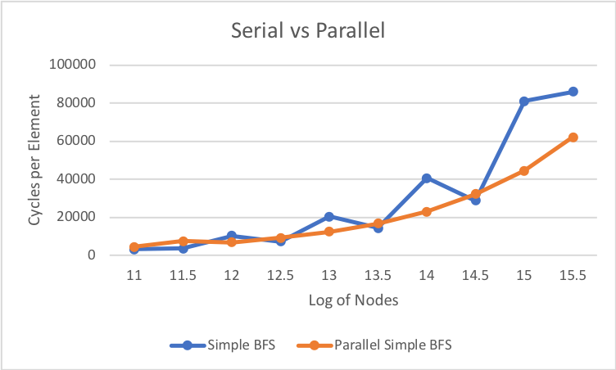
Data Comparison
Overall, the performance of parallelization improves. However, the serial implementation is quite unstable, which sometimes performs better than the parallel implementation.
Reason:
It sometimes spends more time waiting.

Slide 25
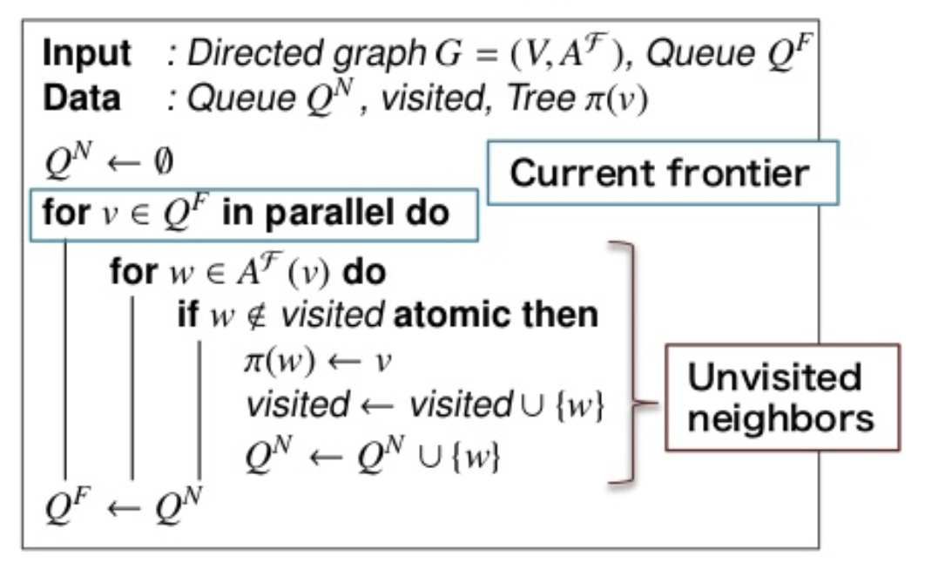
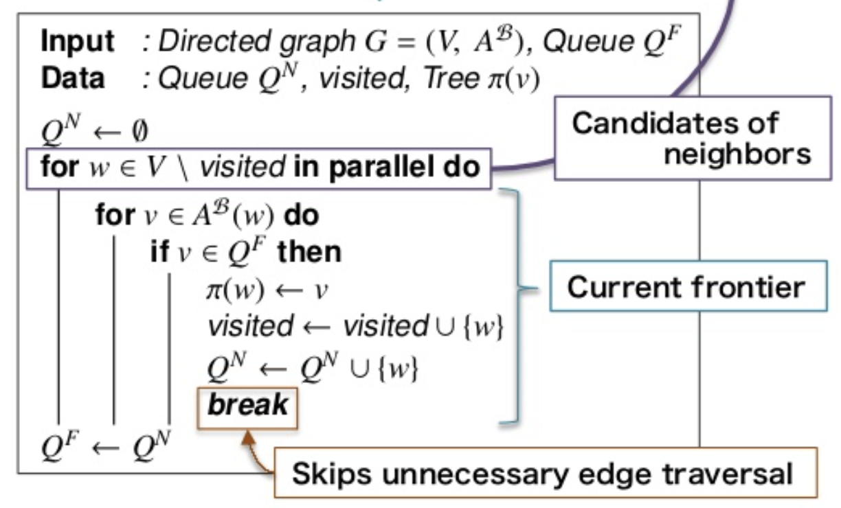
Hybrid Algorithm with Parallelization
Top-Bottom
Bottom-Top
Make good use of barriers: each level of nodes
Image Source: https://www.slideshare.net/yuichiroyasui/research-paper-08yasuiisc14revised

Slide 26
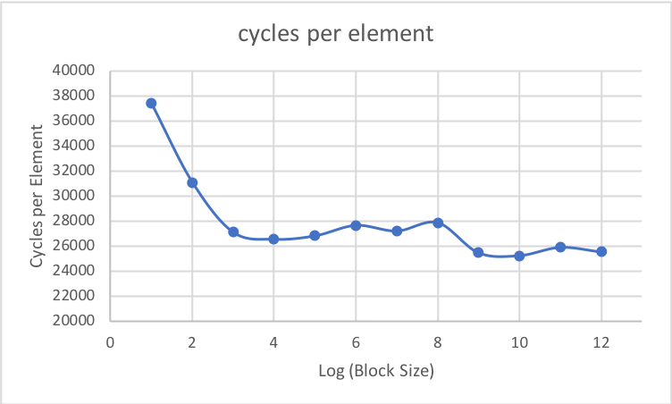
Blocked Parallel Hybrid
Temporal Locality
From the data:
We found the optimized blocked size is 1024 for 32768 nodes.
Overall, as blocked size increase, the number of iterations decreases.

Slide 27
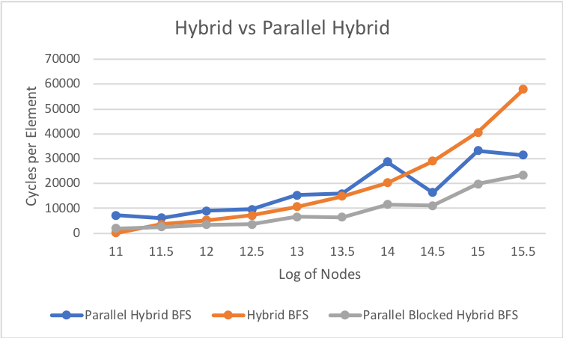
Data Comparison
By comparing serial hybrid, parallel hybrid, and parallel blocked hybrid:
When there are large number of nodes:
Multi Threads are efficient solution
Parallel steps also helps
Overall, parallel blocked hybrid works the best.

Slide 28
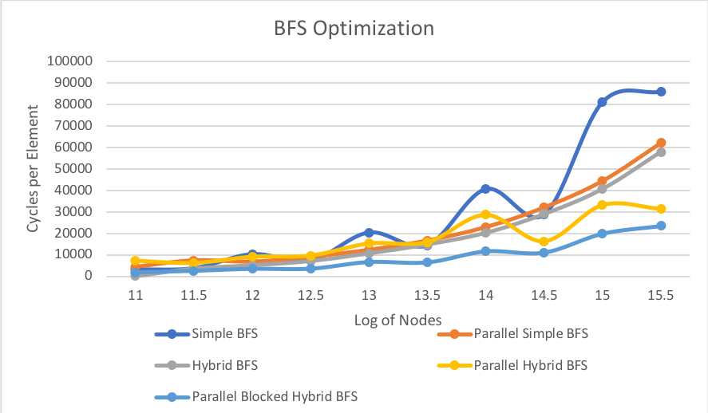
In summary, the efficiency: (Under Large Number of Nodes)
Parallel Blocked Hybrid > Parallel Hybrid > Hybrid > Simple Parallel > Simple

Slide 29
Dijkstra’s Algorithm (GPU)

Slide 30
Definition
Dijkstra's algorithm found the shortest path between two given nodes, but a more common variant fixes a single node as the "source" node and finds shortest paths from the source to all other nodes in the graph.

Slide 31
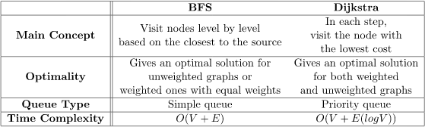
Method
Breadth-first search is just Dijkstra's algorithm with all edge weights equal to 1.
Kernel call to initialize all node weights to infinity except for the source node. We mark the source node as settled after this point.
Kernel Call to choose a node which is relaxed and settled and to relax the outgoing edges of each settled node.
Kernel call to mark all the settled nodes.
Image Source: https://www.baeldung.com/cs/graph-algorithms-bfs-dijkstra

Slide 32
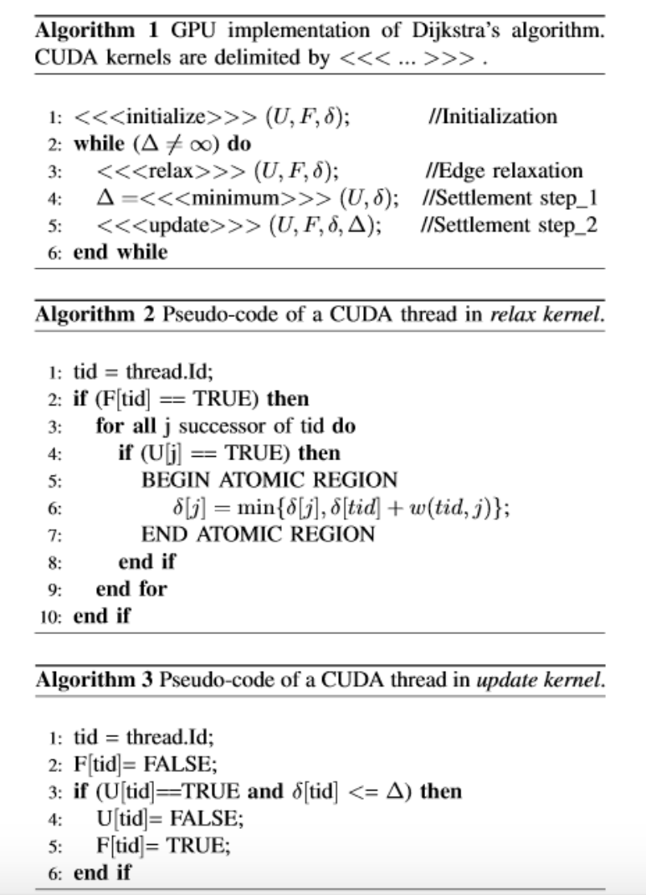
Optimization
Kernel Call to initialize the values of the node weights to infinity except for the Source Node which is set to 0
We mark the source Node to be settled after that and all other nodes unsettled
Kernel Call to choose the node with minimum node weight whose edges are to be relaxed
Kernel call to relax all the edges of a node
Image Source: http://ise.ait.ac.th/wp-content/uploads/sites/57/2020/12/Parallel-Shortest-Path-Algorithms-for-Graphics-Processing-Units.pdf

Slide 33
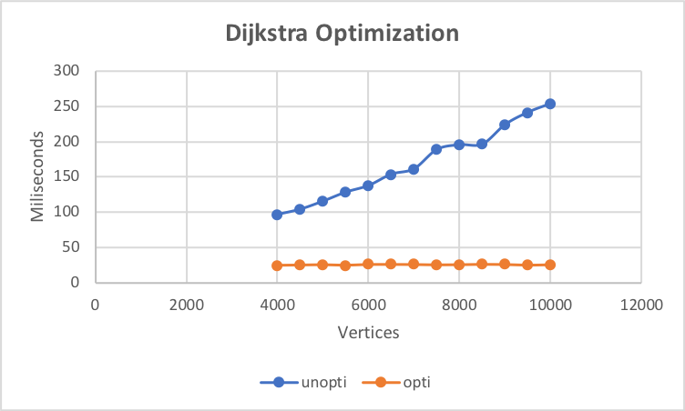
Data Comparison
Under Edge per Nodes = 4000 & Weight of each Edge = 5:
After Optimization, the number of vertices does not seem to have influence on the runtime.

Slide 34
Implementation on GPU

Slide 35
Serial vs Parallel (GPU)
With 1024 threads, 10000000 vertices, 50000000 edges
Sequential Execution Time: 3.81 sec
Kernel Execution Time: 0.02636 sec
Speed up by: 144.554 times

Slide 36
Thank you

